Slide 1
Chapter 29
From Camelot to Watergate

Slide 2
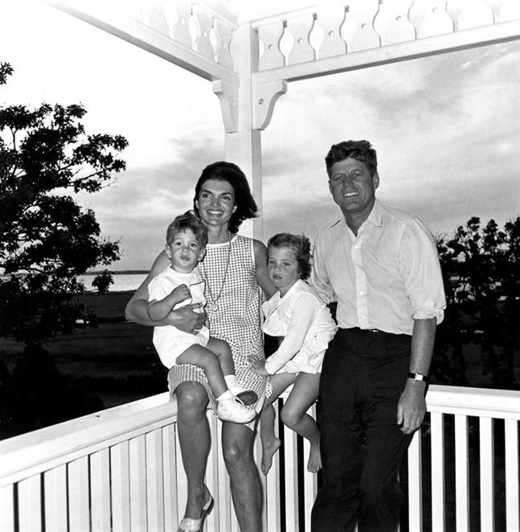
Kennedy’s Camelot
Kennedy’s background

Slide 3
The Cuban Missile Crisis
Background
  Bay of Pigs, April 1961
  Berlin Wall, August 1961
  Soviets resume nuke testing
The Crisis
  Oct. 14, 1962—missiles discovered
  Oct. 22—JFK goes public; what to do?
  Oct. 28—Khrushchev backs down; resolution?
  Effects?

Slide 4
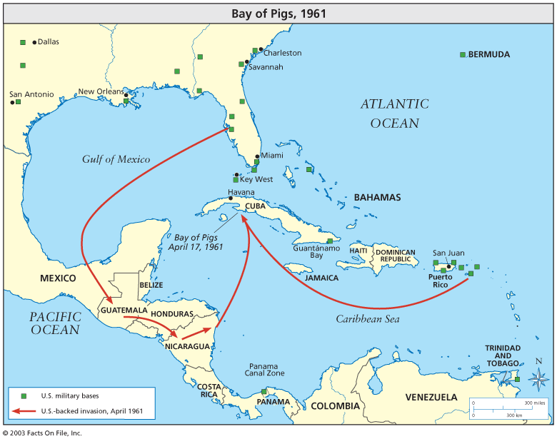

Slide 5
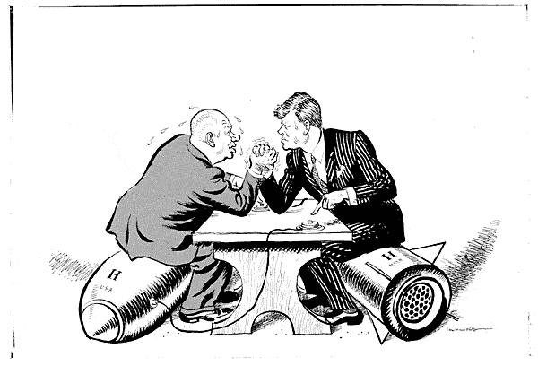
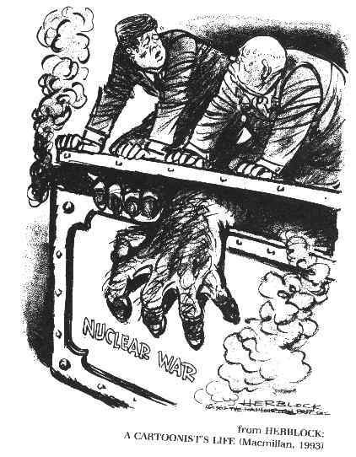

Slide 6
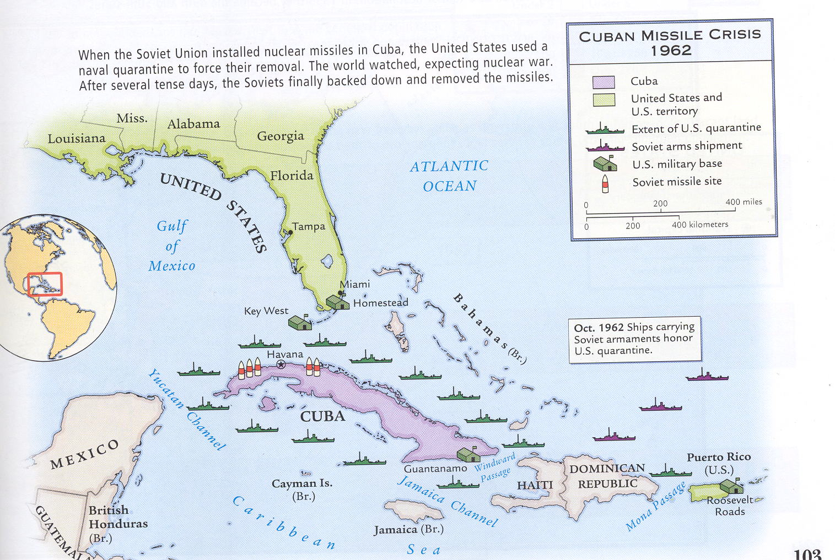

Slide 7
Beginning of Vietnam
Review background
Why support Ngo Dinh Diem?
Ho Chi Minh’s response?; Vietcong
American support
Diem’s overthrow; why?

Slide 8
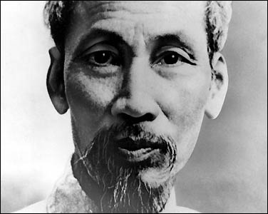
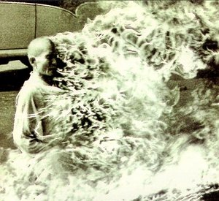


Slide 9
Civil Rights Movement
Brown v. Board of Education, 1954
Death of Emmett Till—Aug. 1955
Dec. 1955—Rosa Parks—Montgomery, AL; Montgomery Bus Boycott (Martin Luther King, Jr.)
Southern Christian Leadership Conference (SCLC), Congress of Racial Equality (CORE) and Student Non-violent Coordinating Committee (SNCC)
1957—Little Rock Nine and Civil Rights Act of 1957
Feb. 1960—sit-in at Woolworth’s in Greensboro, NC
May 1961—”Freedom Rides”
Results/effects?

Slide 10
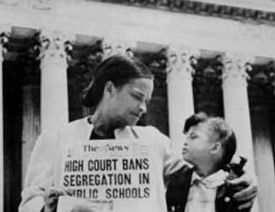
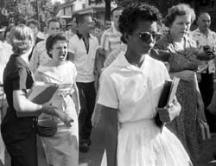

Slide 11
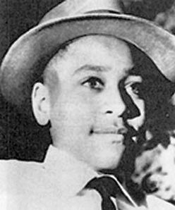
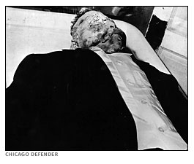

Slide 12
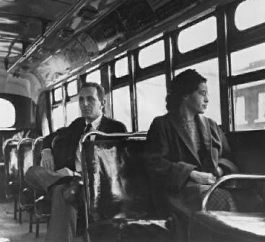
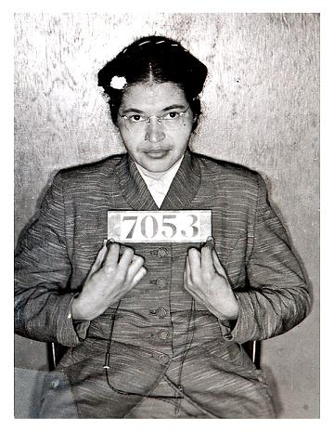
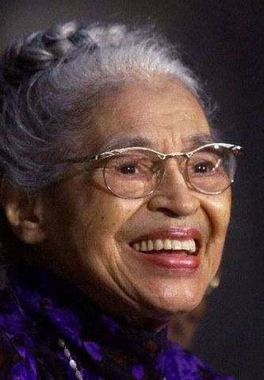

Slide 13
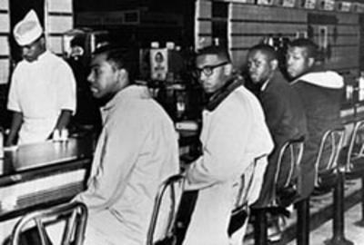
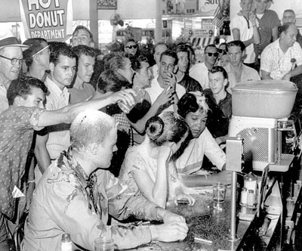

Slide 14
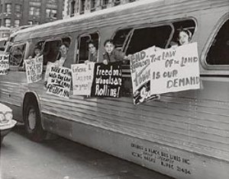
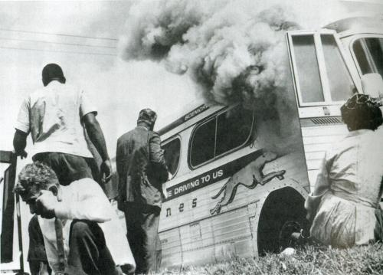

Slide 15
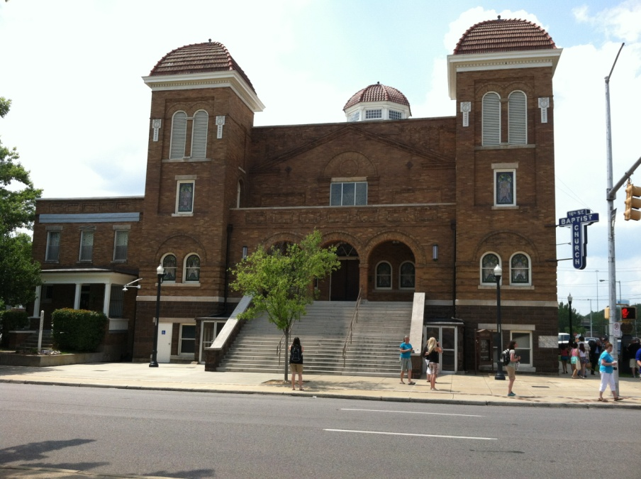
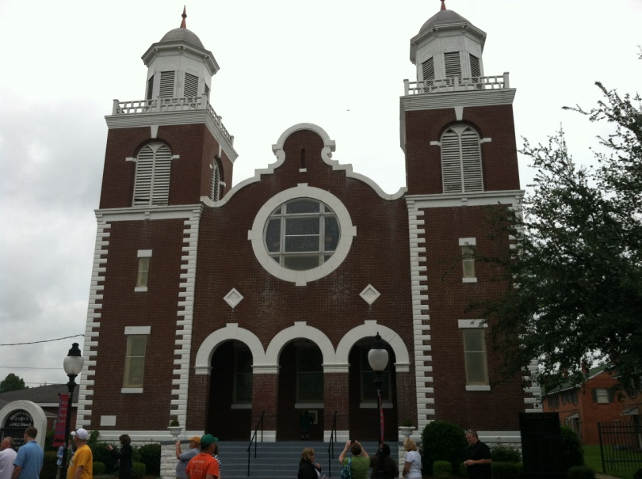
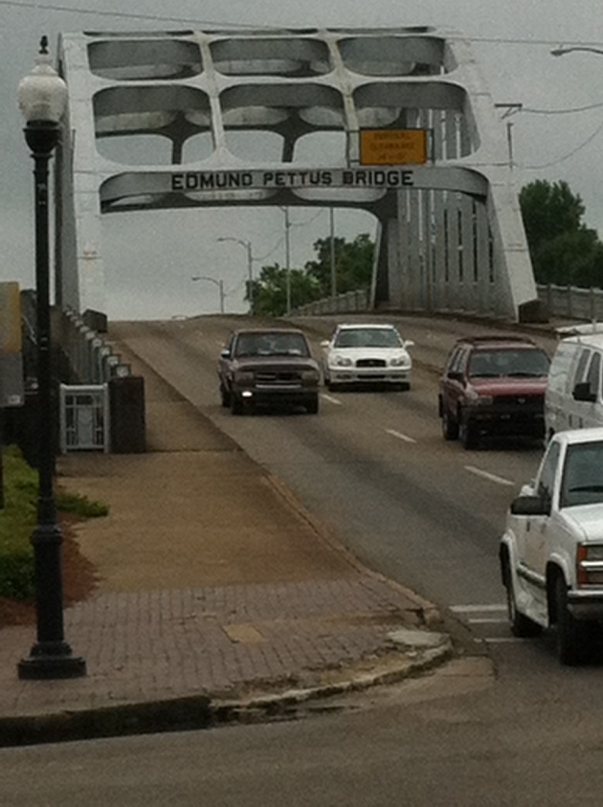
Civil Rights Movement (cont.)
Sept. 1963—Bombing of 16th Street Baptist Church
March 1965—”Bloody Sunday”

Slide 16
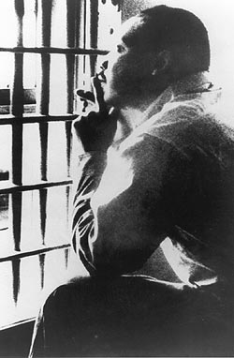
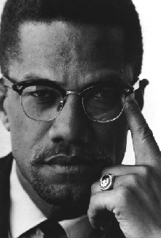
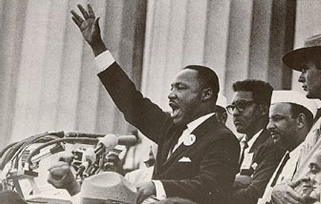
Civil Rights Movement
Opposition—Black Muslims—Elijah Muhammad and Malcolm X
King—”Letter from Birmingham Jail” and “I Have a Dream”

Slide 17
JFK Assassination
Nov. 22, 1963—Dallas, TX
Lee Harvey Oswald—Texas School Book Depository
Jack Ruby
Conspiracy theories
Warren Commission

Slide 18
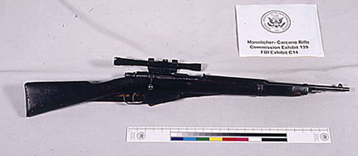
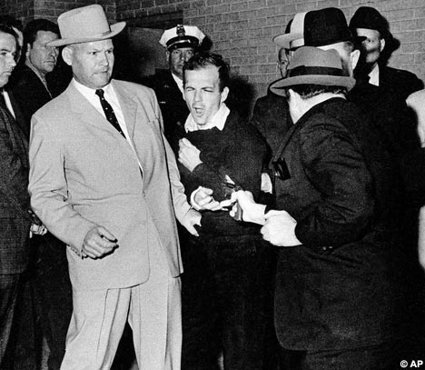
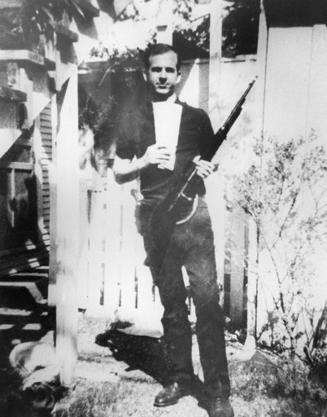
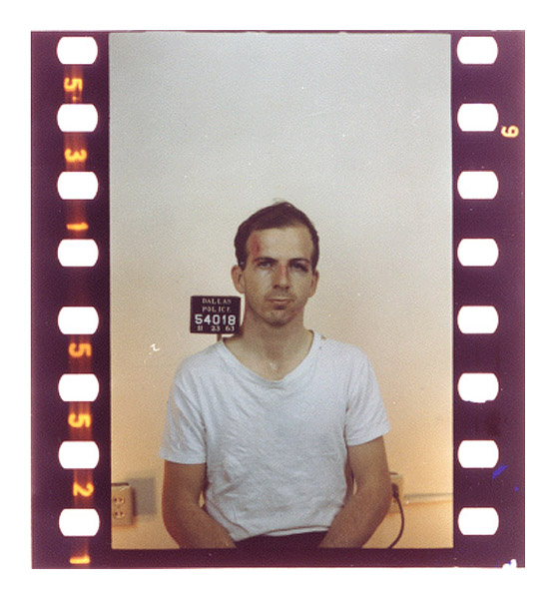


Slide 19
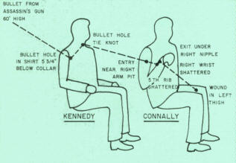


Slide 20
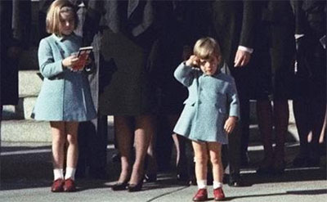
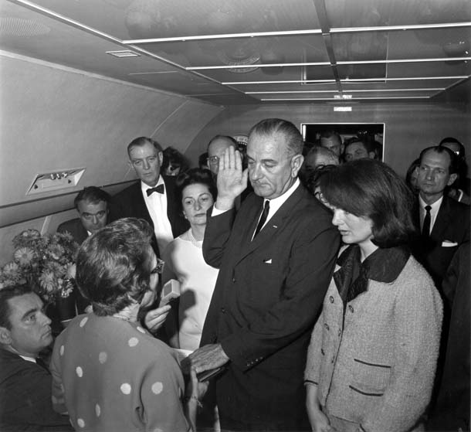

Slide 21
Lyndon Johnson
Background
The Great Society
  Civil Rights Act of 1964
  Economic Opportunity Act of 1964--Head Start
  Medicare/Medicaid (1965)
  Higher Education Act of 1965
  Voting Rights Act of 1965
  Immigration Act of 1965
  National Endowment for the Arts; National Endowment for the Humanities (1965 and 1966)
  Criticisms of Great Society

Slide 22
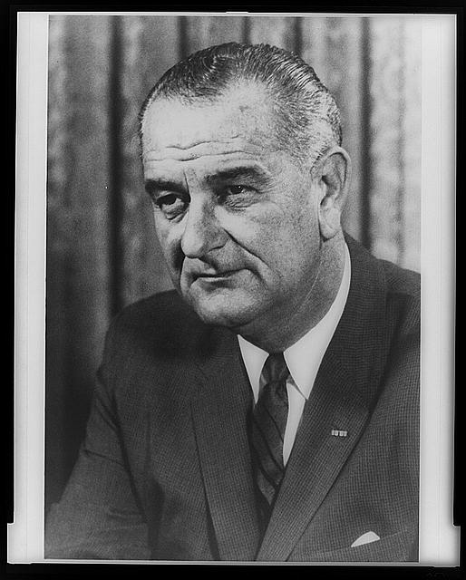

Slide 23
LBJ and Vietnam
Escalated due to pressure created by instability in South Vietnam; role of Great Society?
Gulf of Tonkin Incident; Tonkin Gulf Resolution; opponents?
Mid 1968—538,000 troops; search and destroy missions—why ineffective?

Slide 24
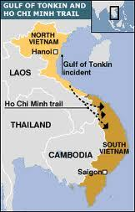
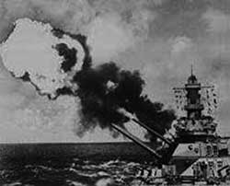

Slide 25
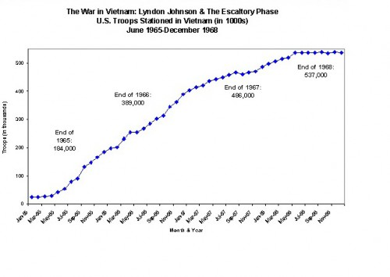

Slide 26
Fighting in Vietnam
Guerilla warfare is perfect
  Jungle—Agent Orange and napalm; disease and jungle rot
  Ho Chi Minh Trail
  Role of Chinese and Soviets
  Use of tunnels
  Friend from foe?
  Booby traps

Slide 27
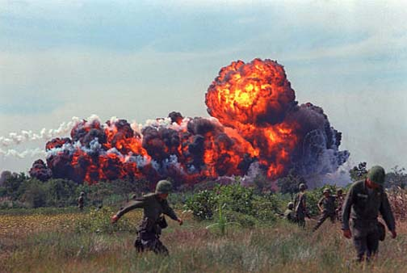
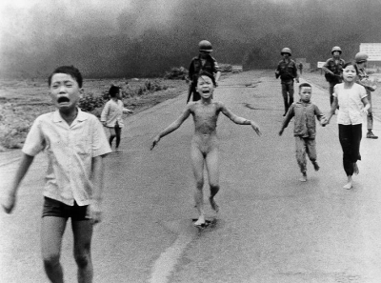
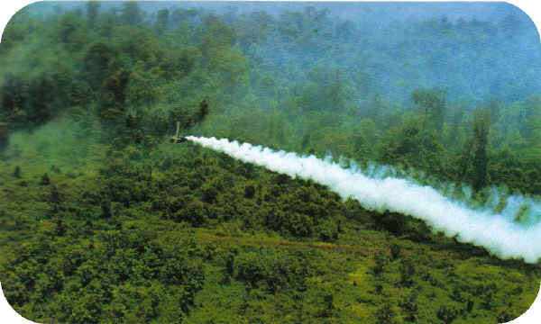
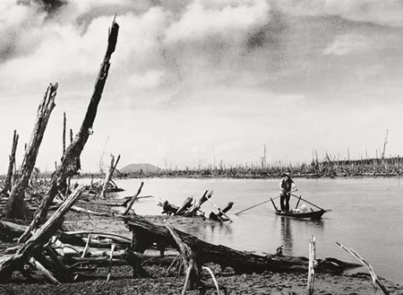

Slide 28
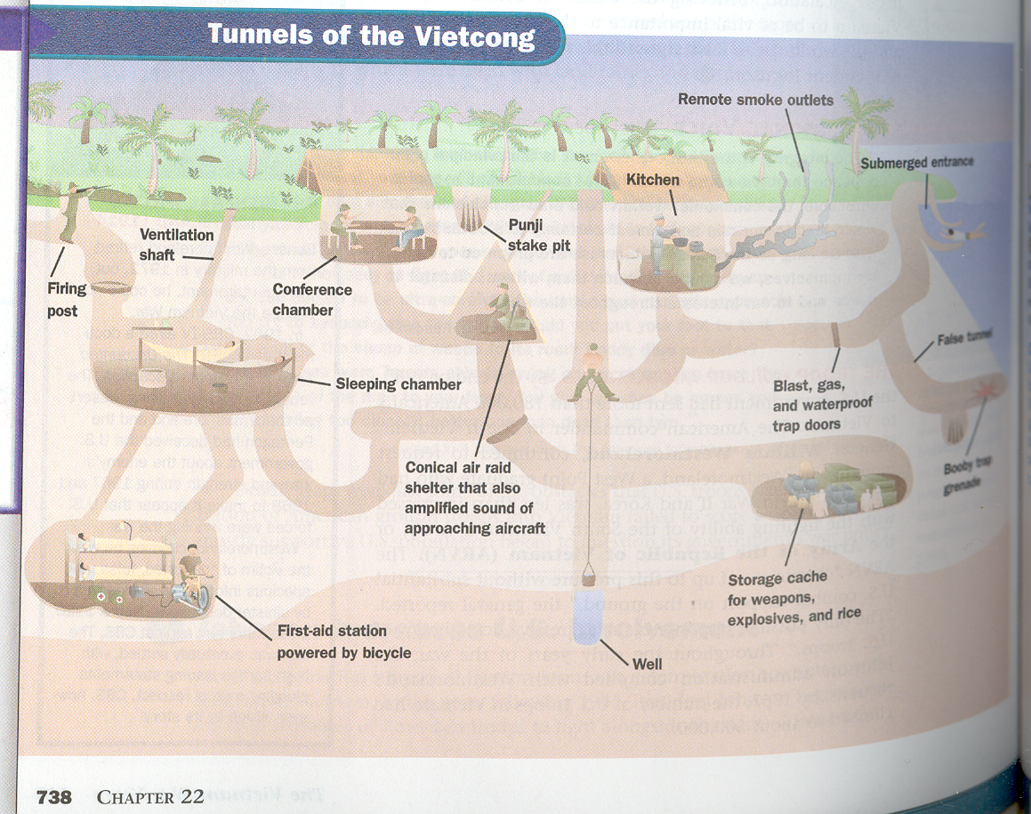

Slide 29
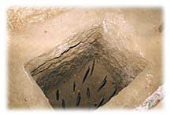
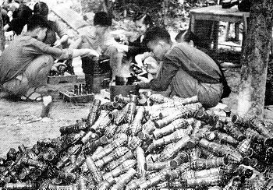


Slide 30
Opposition to the War
American hypocrisy?
Cost of war--$20 billion/year or more; no tax raises; why?
Military victory impossible
Role of blacks and minorities
Rising casualties
Television
Jan. 31, 1968—Tet Offensive
  Effects?

Slide 31
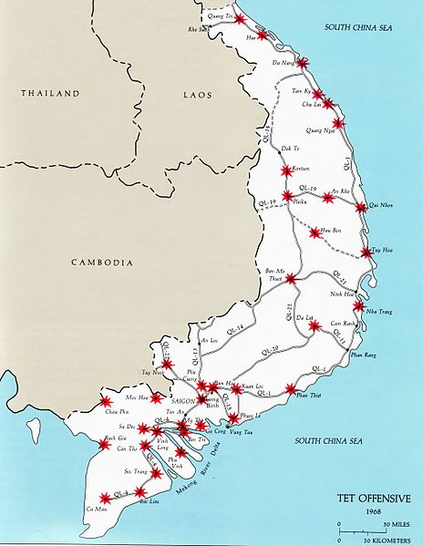

Slide 32

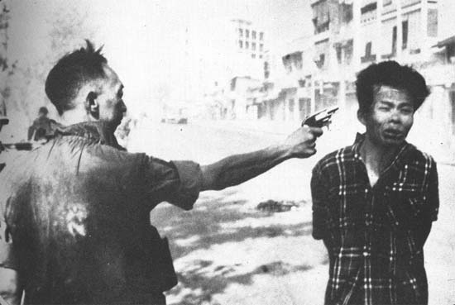

Slide 33
1968—The Turning Point
LBJ chooses not to run for re-election
Eugene McCarthy, Robert Kennedy and George Wallace
April—Martin Luther King, Jr. assassinated
June—Robert Kennedy assassinated
August—Democratic Convention in Chicago
  Violence
  Hubert Humphrey nominated; importance
Richard Nixon/Spiro Agnew elected

Slide 34
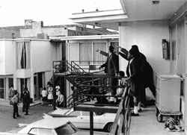
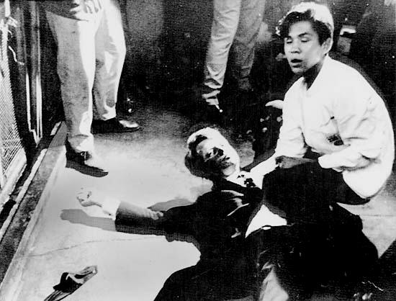
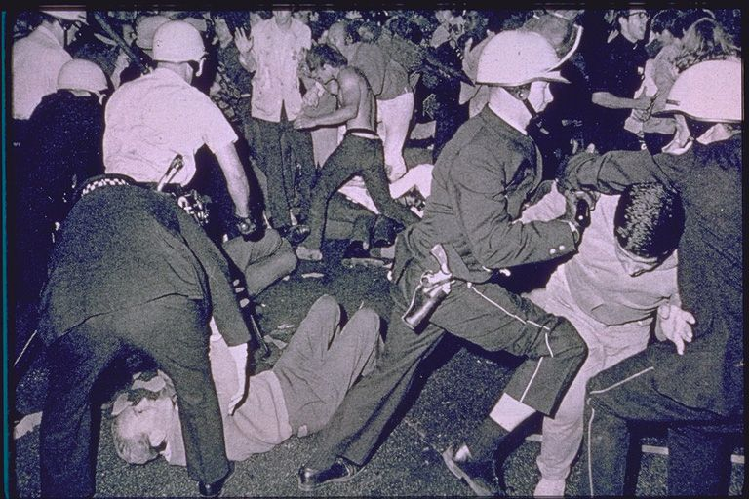

Slide 35
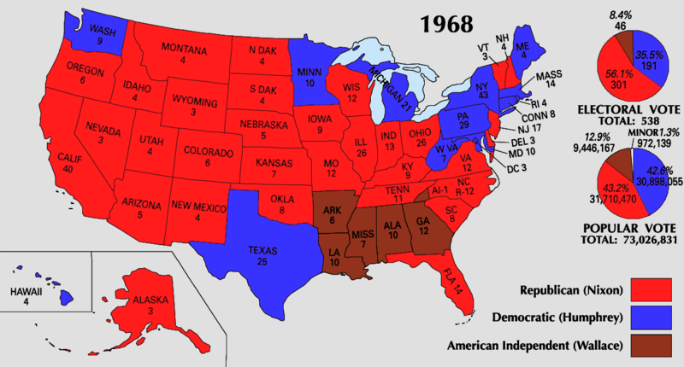

Slide 36
Nixon and Vietnam
Vietnamization
Protests increase
  My Lai Massacre (1968)
  Cambodian “Incursion” (1970)
    Kent State University—May 1970
    Increase bombing

Slide 37
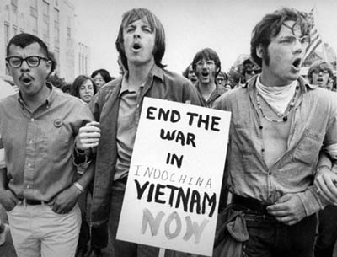
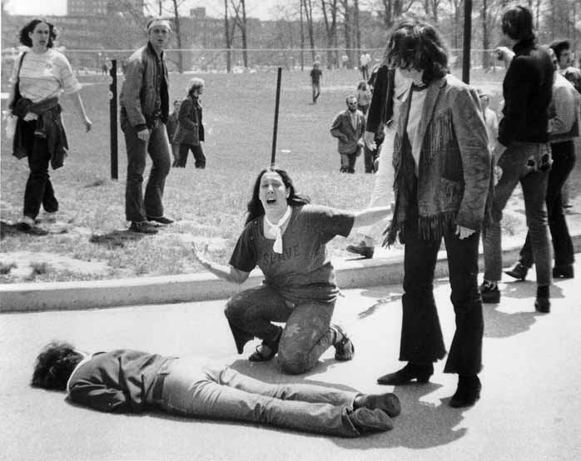


Slide 38


Détente 1972
Henry Kissinger; relaxation of tensions
How to do this?
Results
  Economic concessions to China; recognize communist China
  SALT treaty with Soviets; sale of grain

Slide 39
End and Effects of War
Election of 1972—McGovern v. Nixon; Nixon and the South
Jan. 1973—peace agreement; said?
Saigon captured in April 1975
57,000 killed, 300,000 wounded
Cynicism toward government—Pentagon Papers
Counterculture movement
Treatment of soldiers—then and now

Slide 40



Slide 41


Slide 42
Nixon’s Domestic Policy
Stagflation—stagnant economy combined with inflation; temporarily freeze prices and wages
Creation of Environment Protection Agency (EPA) and Clean Air Act (1970)
Distances himself by minorities—true equality means not favoring one race over another; cuts anti-poverty programs and others
“Impoundment” of funds

Slide 43
Watergate
CREEP—”Plumbers”
June 17, 1972
Cover-up and document shredding
Bob Woodard and Carl Bernstein
What did Nixon know and when did he know it?
Revelation of tapes; executive privilege
“Saturday Night Massacre”
Erased gaps in tapes

Slide 44



Slide 45
Watergate and Other Problems
Agnew’s resignation and appointment of Gerald Ford
Income tax questions
United States v. Richard M. Nixon, 1974
House Judiciary Committee moves to impeach; Nixon resigns
Ford president; pardons Nixon—why? Effects?

Slide 46



Slide 47
Tying It All Together
Examine the major events and importance of the Civil Rights Movement.
Evaluate Lyndon Johnson’s presidency.
Summarize the Vietnam War: causes, major events and effects.
Evaluate Richard Nixon’s presidency.

